Slide 1
Multiple linear regression

Slide 2
Terminology
There are several equivalent terms in the regression context. You should be aware of them.
Feature.
Covariate.
Independent variable.
Explanatory variable.
Predictor.
Input.
Regressor.
Output.
Outcome.
Response.
Dependent variable.
x
y

Slide 3
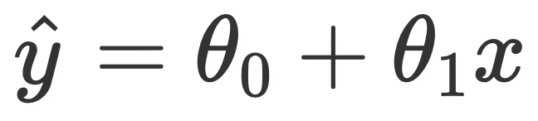


Adding independent variables
First, some terminology. For our purposes, all of these terms mean the same thing:
Feature.
Covariate.
Independent variable.
Explanatory variable.
Predictor.
Input.
Regressor.
In the regression context, each of the above things has a “weight” assigned to it, given by the parameter. We also call these weights “coefficients.” For instance, in , we might say the “weight” associated with the constant/intercept term is , and the “weight” associated with the x term is .

Slide 4
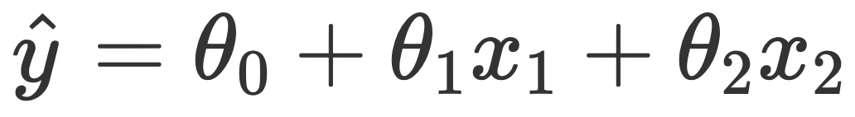
Adding independent variables
A linear regression model with two features (and thus, three parameters), is of the form
For example, suppose we want to create a linear regression model that predicts the number of points a player in the NBA averages (PTS). Using just the number of assists (AST) they average might yield a model of the form
If we use both AST and the number of 3PT field goal attempts they make (3PA), we may have
(These coefficients were determined by minimizing average squared loss, in the companion notebook.)

Slide 5
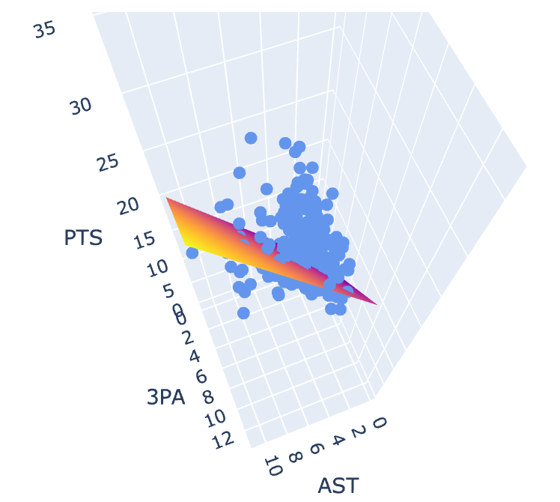
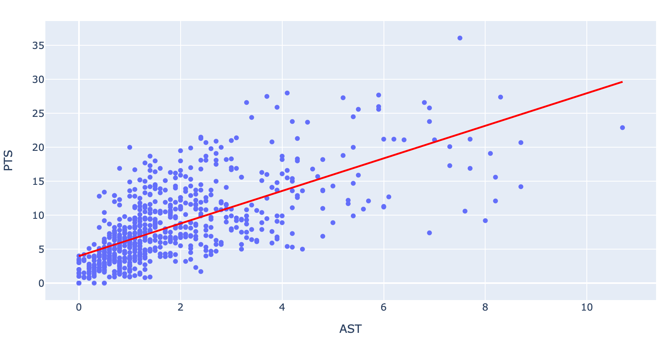
Visualizing higher-dimension models
In both of the below plots, the blue circles represent the true observations.
On the left, the red line represents the model obtained by using only AST.
On the right, since we now have two independent variables, our model is a plane in 3D.

Slide 6
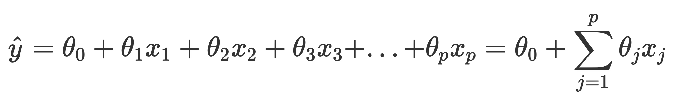
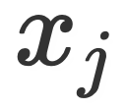
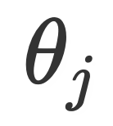
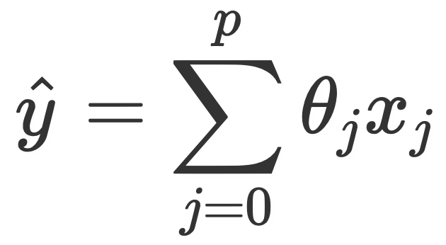
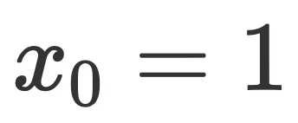
Multiple linear regression
In general, the multiple linear regression model is of the form
We say this model has p features, plus an intercept term.
The weight associated with feature is .
If we set for each observation, then we can simplify further:
This is the notation we will use moving forward.
Think about how you can rewrite this in terms of a vector multiplication!
Be careful: xj here refers to feature j, not data point j.

Slide 7
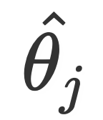
Multiple linear regression
Model 1:
Model 2:
These are different models! In general, in one model will not be equal to in another model.
2.4 is the slope of the relationship between AST and PTS, when only considering those two variables.
Parameters [3.98, 2.4] minimize average squared loss for Model 1.
1.64 is the slope of the relationship between AST and PTS, when also considering 3PA.
Parameters [2.163, 1.64, 1.26] minimize average squared loss for Model 2.
different!

Slide 8
RMSE and Multiple R² https://github.com/justmarkham/scikit-learn-videos/blob/master/06_linear_regression.ipynb

Slide 9
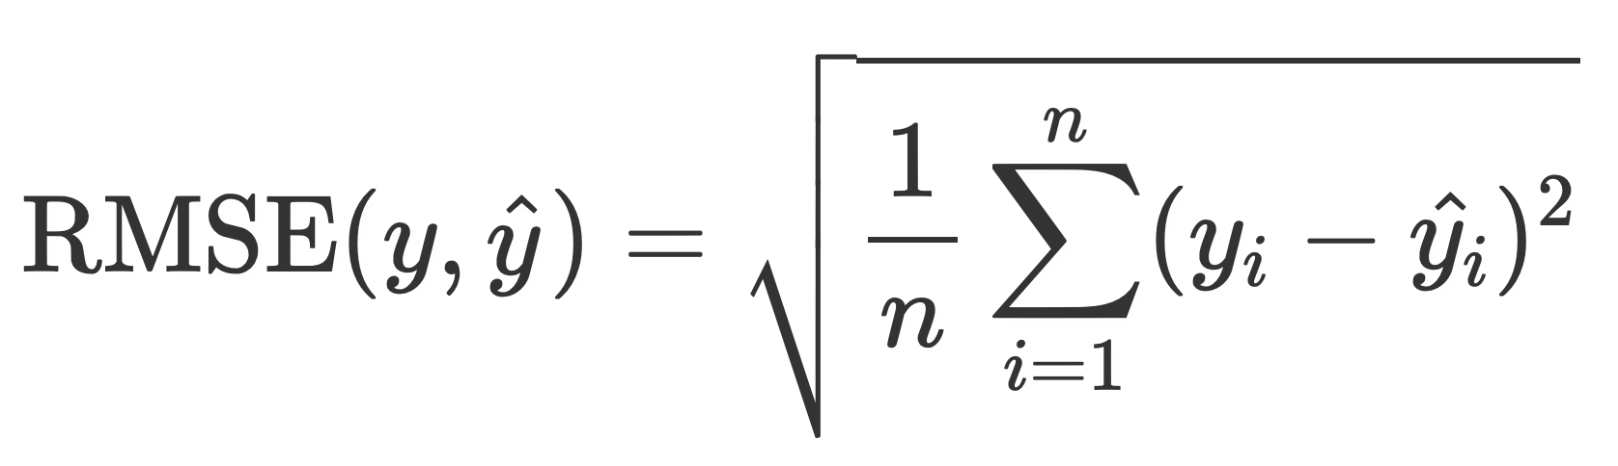
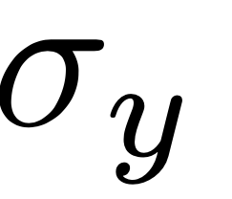
Comparing RMSEs
For the constant model with squared loss, RMSE is .
MSE(sample mean) = sample variance.
This is a good baseline to compare with.
Using just the data we trained our model on, it is impossible for RMSE to go up by adding features.
If a new feature (e.g. “does a player like the color red?”) we’ve added doesn’t help lower average loss, its weight will just be set to 0.
When we start evaluating models on unseen data, this is no longer true.
Soon, we will look at “training error” and “testing error”. The errors that we look at are RMSEs.
Has an RMSE of 4.29 on the NBA dataset.
Has an RMSE of 3.64 on the NBA dataset.

Slide 10
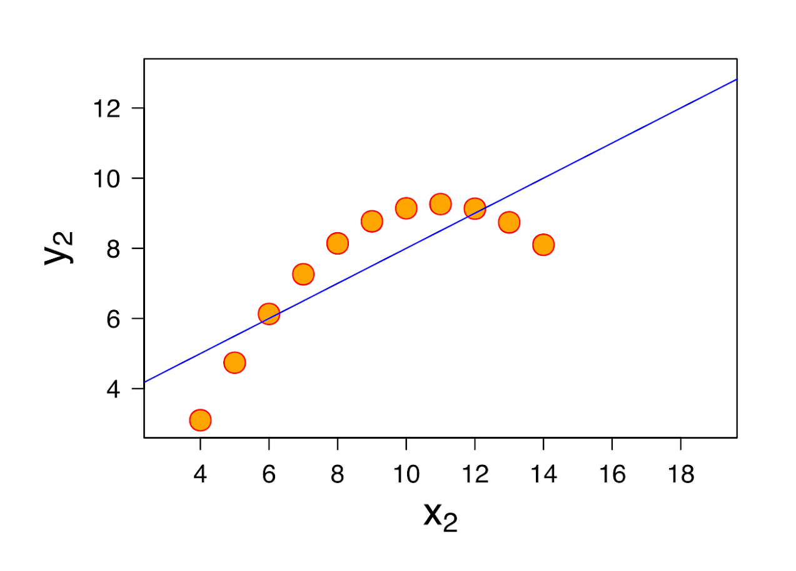
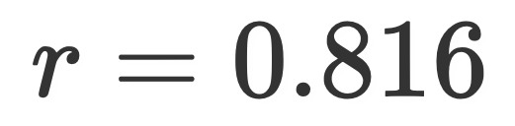
Multiple R²
Here we have multiple features. We could (and sometimes do!) look at the correlation between each feature and our true y values individually.
However, we are also interested in measuring the strength of the linear association between our actual y and predicted y.
We want this relationship to be as close to the line y = x as possible.

Slide 11
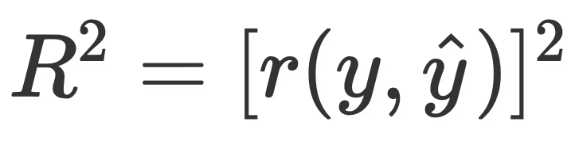
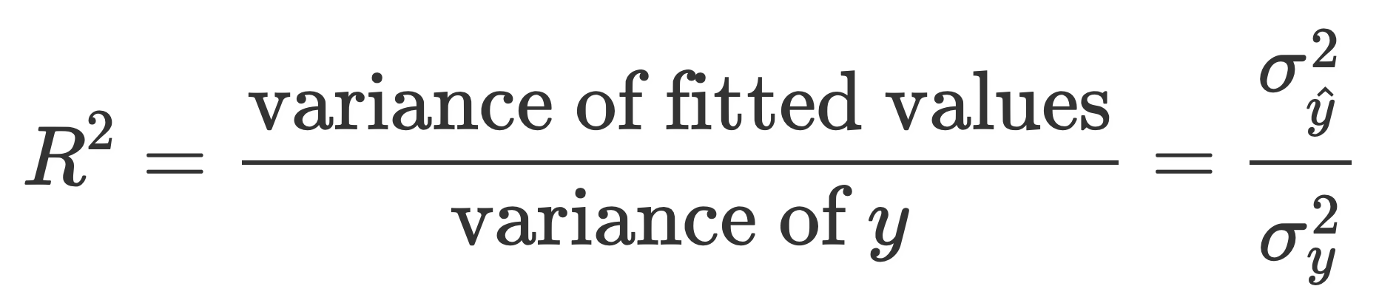
Multiple R²
We define the multiple R² value as the square of the correlation between the true y and predicted y. This is also referred to as the coefficient of determination.
Since it is the square of a correlation coefficient (which ranged between -1 and 1), R² ranges between 0 and 1. Another way of expressing R², in linear models that have an intercept term, is
Thus, we can interpret R² as the proportion of variance in our true y that our fitted values (predictions) capture, or “the proportion of variance that the model explains.”

Slide 12
Multiple R²
As we add more features, our fitted values tend to become closer and closer to our actual y values. Thus, R² increases.
The simple model (AST only) explains 45.7% of the variance in the true y.
The AST & 3PA model explains 60.9%.
Adding more features doesn’t always mean our model is better, though!
R² = 0.457
R² = 0.609

